Slide 1
Unit Conversion Tool
Composed by Anne Szarek, Isaiah Crothers, and Shaquan Hagans
Notes:
Introduce ourselves and the title

Slide 3
Introduction
What did this project start from?
Where did we get this idea?
How did we get here?
Notes:
Shaquan speaks now

Slide 4
The Big Goal
The goal of the code that our group created was to make a tool that could be used by any given individual to take one form of measure and be able to convert it to another on the fly.
This makes for more streamline efficiency
We used many different forms of measure, including inches, millimeters, miles, yards, and around four others as well.
Notes:
Isaiah speaks now

Slide 5
Making The Code
Notes:
Isaiah speaks now

Slide 6
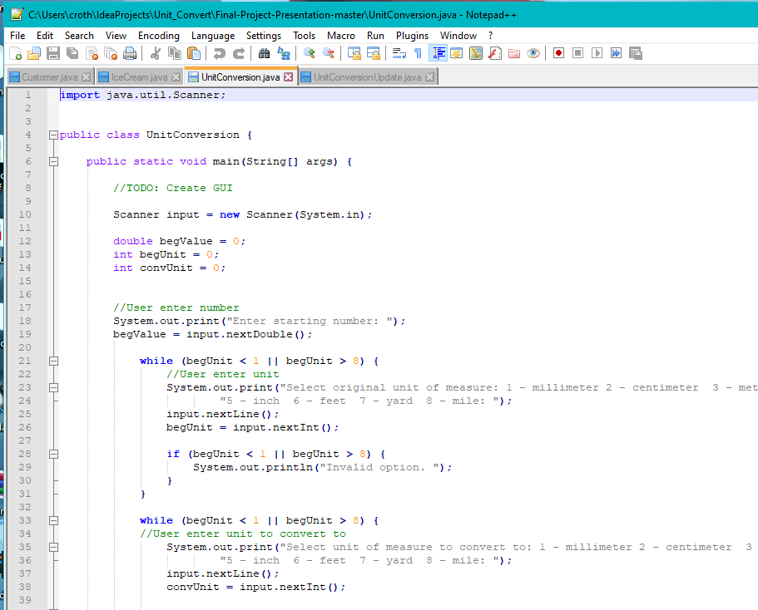
Screenshot of the code during its conception.
Notes:
Isaiah speaks now

Slide 7
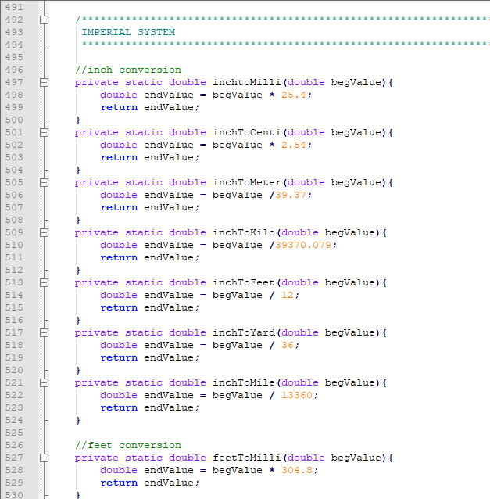
Conversions
Making sure that all the conversions are valid and equate out to the correct output.
The conversions were made using a bunch of private double methods
Used the beginning value of user
Multiplied by the the given amount
Returned the final value to the code to e outputted to the GUI.
There were over 40 different unique methods to be made.
Notes:
Isaiah speaks now

Slide 8
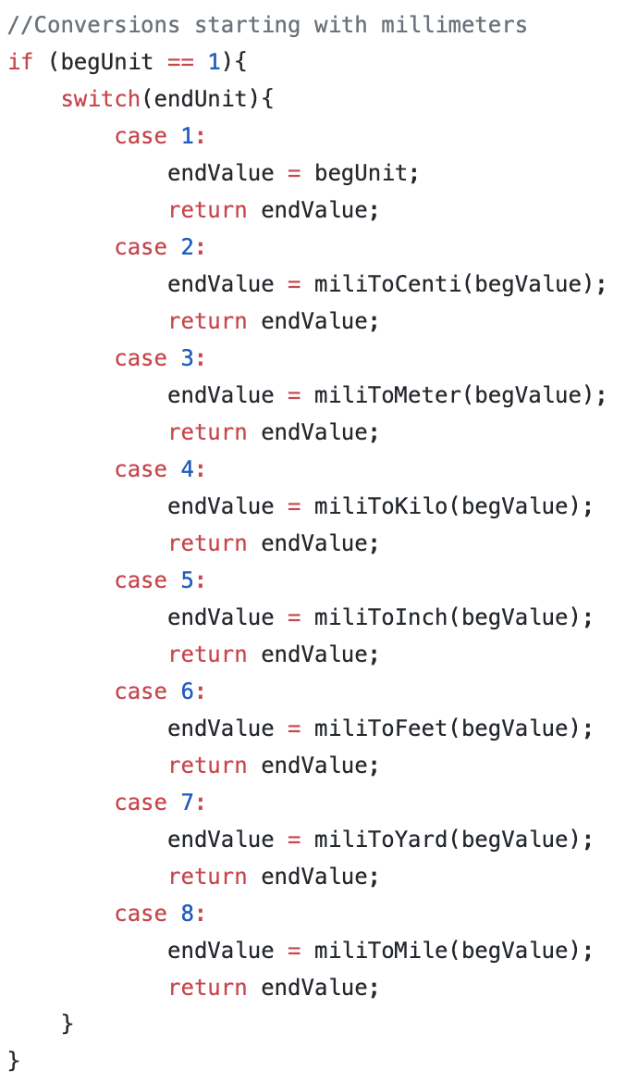
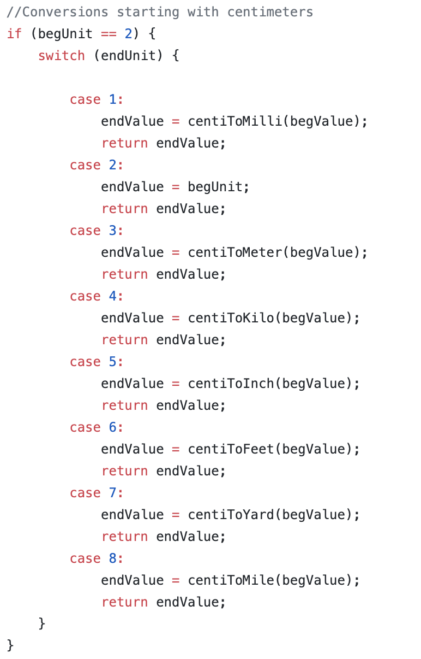
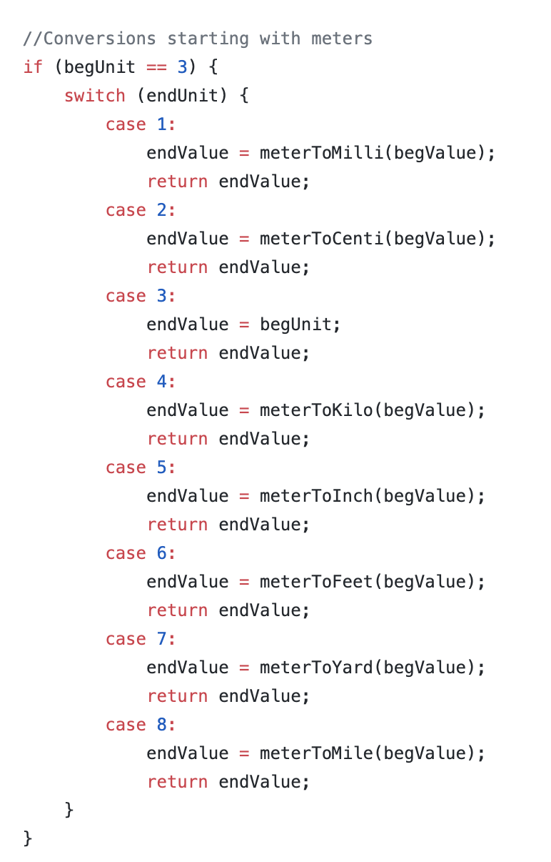
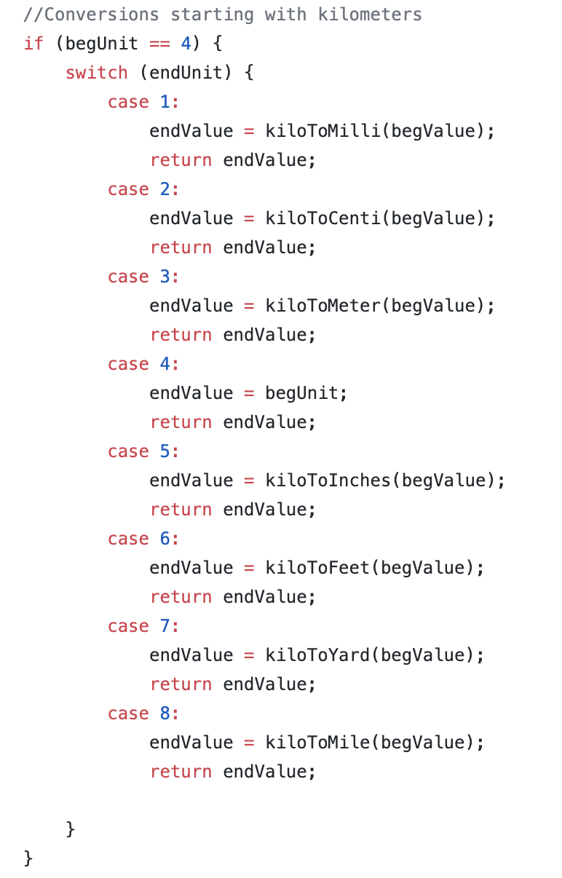
Switch Cases?
The switch cases in this code were utilized to determine which type of conversion a user wanted to pursue
There were several cases per each individual unit of measure
Notes:
Anne speaks now

Slide 9
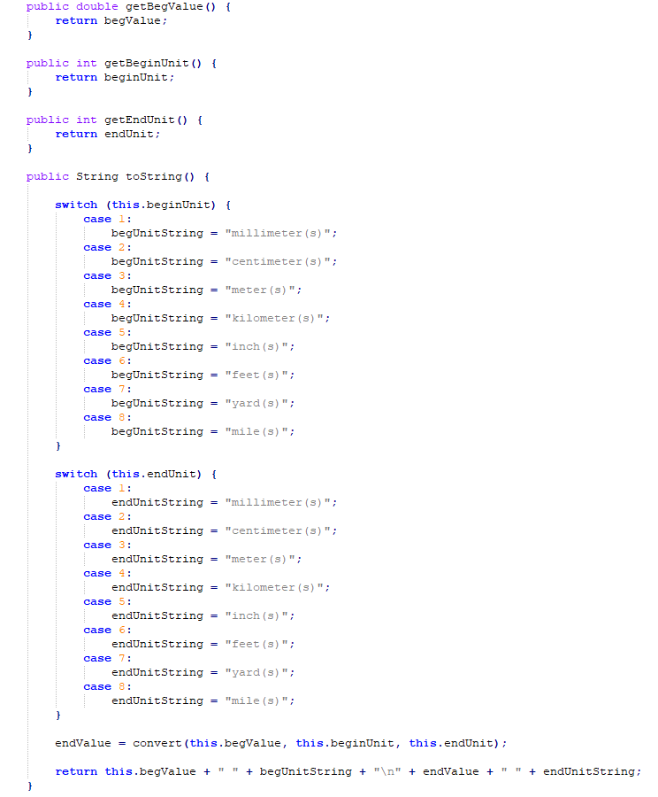
Valid Data Entry
One of the absolute most important parts for the code to run was the ability to check for valid data inputs.
The user entered values of measure could only be entered in as integers.
The choice of conversion from one to another was limited to selection of choices 1 through 8 to provide more streamlined processing.
Done with utilization of switch cases
Notes:
Anne speaks now

Slide 10
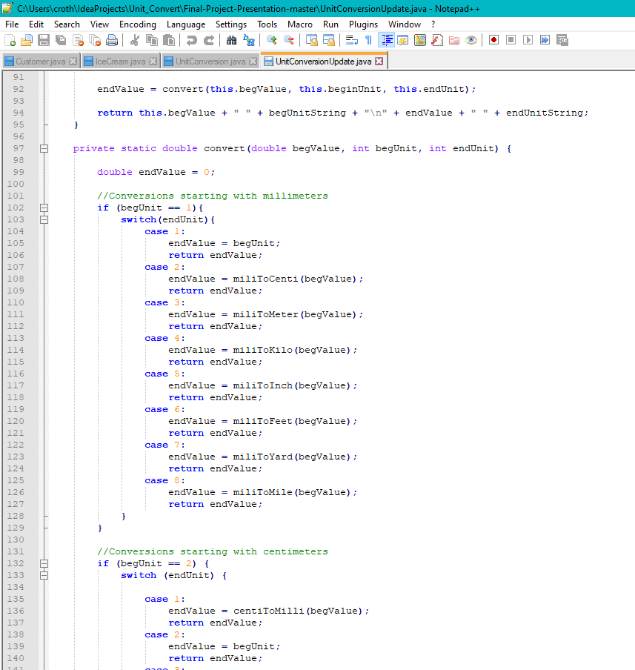
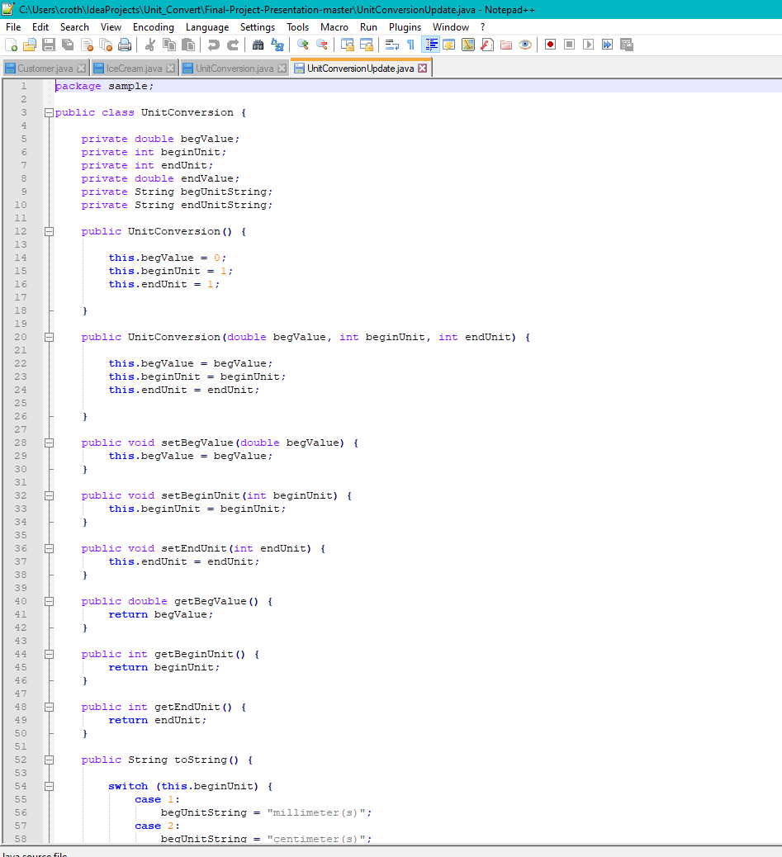
Finished code, including loops, switch cases, print statements, etc.
Notes:
Anne speaks now

Slide 11
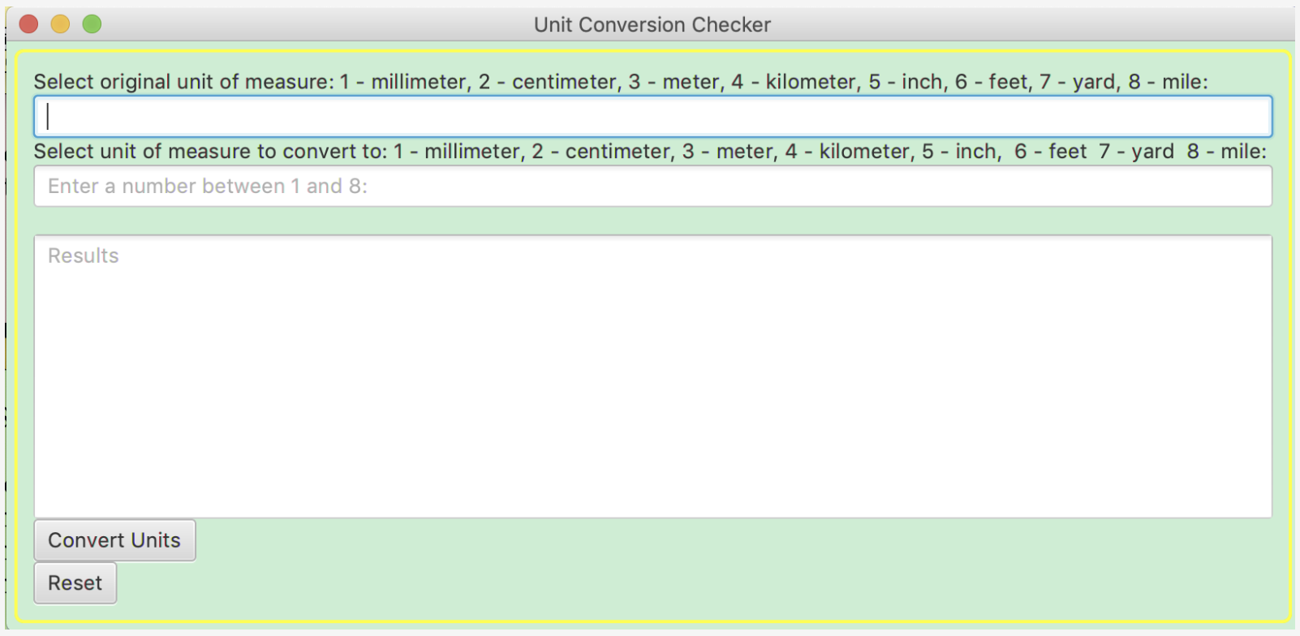
Creating the Object
The object for our code was developed with the goal in mind of simplicity
We wanted to create an object that wasn’t overly complicated
The object created has a simple number entry that allows the user to simply enter in the number that they wish to convert from and to.
The results are then outputted, to the exact measure in big bold text, easy to read.
Notes:
Shaquan speaks now

Slide 12
The GUI
Notes:
Shaquan speaks now

Slide 13
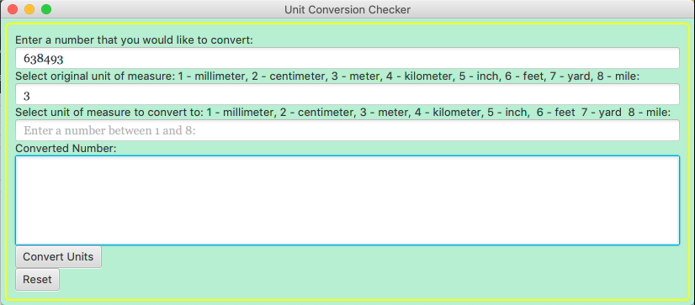
The finished GUI without any inputs or results.
Notes:
Shaquan speaks now

Slide 14
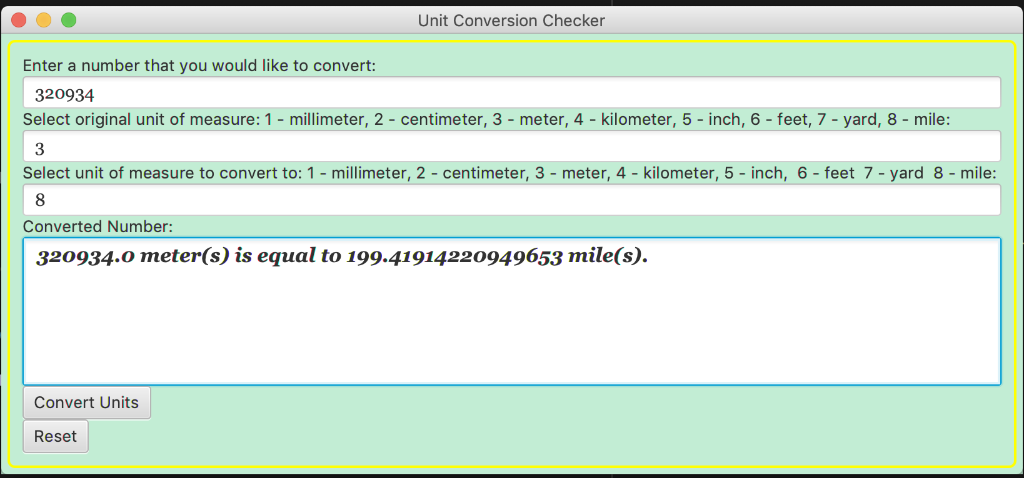
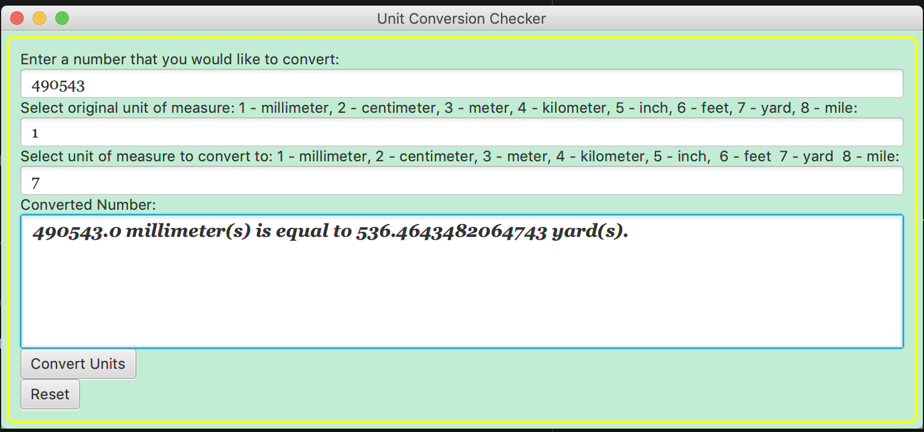
The final output and inputs after being inputted into the GUI.
Notes:
Test Cases: Utilizie big differences, hence like centimeters to miles, or using millimeter to yards.

Slide 15
Thanks for coming to our TED Talk!

